Slide 1

CV RAMAN GLOBAL UNIVERSITY
Diabetic Readmission prediction

Slide 2
C.V RAMAN GLOBAL UNIVERSITY
Under the guidance and supervision of
Prof.Soumya Sahoo
NAME | REGD. NO
Umashankar Pradhan | 2201020602
Gayatri Mohanty | 2201020326
Truptimaye khuntia | 2201020440
Kumari jayanti | 2201020441

Slide 3
Outlines
Introductions
Literature Study
Problem Statements
Technical Details
Result and Discussion
Conclusion
References

Slide 4
Introduction
Hospital readmission rates for certain conditions like diabetes are now considered an indicator of hospital quality, and also affect the cost of care adversely.
So, we use the medical dataset available on UCI to find best models which can help predict the readmission of diabetic patients.
Used Python and it’s libraries like scikit-learn for machine learning, seaborn and matplotlib for visualization etc.
Using different models like Logistic Regression, Decision trees, Random forest and AdaBoost Classifier.
Out of the different models used, Random forest had good performance.

Slide 5
Literature reviews
Journal - Publisher and Year | Title and Author(s) | Methodology | Finding | Limitation
BioMed Research International - Hindawi (2014) | Impact of HbA1c measurement on hospital readmission rates: Analysis of 70,000 clinical database patient records â€” Beata Strack et al. | Retrospective analysis using multivariable logistic regression on ~70k inpatient diabetes encounters from the dataset; controlled for demographics, severity, admission type. | HbA1c was infrequently measured (â‰ˆ18.4%). Measurement associated with lower early readmission for some primary diagnoses; suggests HbA1c testing may improve outcomes. | Observational design; limited causal claims; missingness in HbA1c; potential coding biases in administrative data.
Computer Methods and Programs in Biomedicine - Elsevier (2018) | An improved support vector machine-based diabetic readmission prediction â€” Shaoze Cui et al. | SVM classifier enhanced with a genetic algorithm for feature selection/parameter tuning; compared to baseline methods. | Reported accuracy ~81.0%, sensitivity ~82.9% and improved performance vs some baselines on the dataset. | Potential overfitting, limited external validation; class imbalance handling details limited.
IEEE BIBM Conference (2017) | A self-adaptive 30-day diabetic readmission prediction model based on incremental learning â€” Peng Zhao, Illhoi Yoo | Incremental learning approach to update predictive model on streaming/accumulating data; experimental evaluation on the UCI diabetes dataset. | Proposed self-adaptive framework showed promise for updating models with new data and maintaining performance over time. | Conference paper with limited patient-level evaluation details; reproducibility depends on incremental setup choices.
arXiv / preprint (2020) | EmbPred30: Assessing 30-days Readmission for Diabetic Patients using Categorical Embeddings â€” Sarthak Sarthak et al. | Deep neural network using categorical embeddings for high-cardinality features; compared embedding-based DNN vs standard ML models. | Reported very high accuracy (~95.2%) and AUROC (~97.4%) on the Diabetes 130-US hospitals dataset (claims in preprint). | Preprint (not peer-reviewed); impressive metrics may partly reflect preprocessing choices or data leakage; requires careful validation.

Slide 6
Expert Systems with Applications - Elsevier (2015) | Predictive modeling of hospital readmissions using metaheuristics and data mining â€” Bichen Zheng et al. | Compared metaheuristic-optimized classifiers (e.g., PSO-SVM) and other data mining methods for readmission prediction. | PSO-SVM achieved high sensitivity and competitive accuracy; metaheuristics improved parameter search. | May not focus solely on diabetic subset; generalizability and clinical interpretability concerns.
BMC Medical Informatics and Decision Making (2021) | The 30-days hospital readmission risk in diabetic patients â€” Y. Shang et al. | Established and compared ML-based readmission prediction methods using the UCI diabetes dataset; multiple models evaluated. | ML models provided moderate predictive performance; identified key risk factors and emphasized model comparison. | Performance limited for unplanned readmissions; need for richer features and external validation.
Journal of Medical Artificial Intelligence (JMAI) / review (2024) | Comparison of machine learning models for predicting 30-day readmission in patients with diabetes â€” VB Liu et al. | Compared 10 ML methods and 1 DL for 30-day readmission prediction using the diabetes dataset and similar cohorts. | Highlighted model differences and that no single method dominates across all metrics; emphasized preprocessing and fairness considerations. | Review/benchmark dependent on authors' preprocessing and hyperparameter choices; dataset shifts may affect results.

Slide 7
Problem Statement
Background: Hospital readmissions among patients with diabetes are frequent and costly. Early identification of high-risk patients can help target follow-up care, reduce avoidable readmissions, and improve outcomes.
Objective: Build a supervised machine learning model that predicts the likelihood of a diabetic patient being readmitted soon after discharge (treated as a binary outcome: readmitted vs not; aligned to near-term/30-day risk in this analysis).
Data: Use diabetic_data.csv (with IDS_mapping.csv for diagnosis code grouping) containing demographics, prior utilization (e.g., inpatient/emergency/outpatient counts), length of stay, medication and lab counts, and diagnosis/procedure-related features. The label is derived from readmitted, encoded into 30readmit.
Scope:
Perform data cleaning and encoding.
Train baseline and tree-based models (e.g., Logistic Regression, Decision Tree, Random Forest, AdaBoost).
Compare models on a held-out test set and interpret top features.
Success Criteria:
Primary: Improve predictive performance over a naïve baseline (majority class) on the test set.
Secondary: Balanced performance across classes with attention to recall/precision for the positive (readmitted) class; report Accuracy, ROC-AUC, PR-AUC, F1, and confusion matrix.
Interpretability: Provide feature importance insights to inform clinical understanding.
Assumptions & Constraints:
Class imbalance is expected; appropriate handling (e.g., class weights) may be necessary.
Data reflects a single historical cohort; external validity may be limited.
The model supports decision-making; it does not prescribe treatment and is not a substitute for clinical judgment.
Out of Scope:
Real-time deployment, economic impact modeling, or clinical workflow integration.
Causal inference or treatment effect estimation

Slide 8
Process Flow
Process used:-
Data Collection
Data Wrangling(Missing values, Data cleaning, standardization etc.)
EDA & Visualizations
Modelling:
Logistic
Decision Trees
Ranadom Forest
AdaBoost Classification

Slide 9
Data Requirements & Collections
The data source used was the UCI website, it represents 10 years (1999-2008) of clinical care at 130 US hospitals and integrated delivery networks.
It includes over 50 features representing patient and hospital outcomes. There are around 1,00,000 records.
The data was available in the form of Excel sheet.
It was read in the Python file and the analysis was performed on that data.

Slide 10
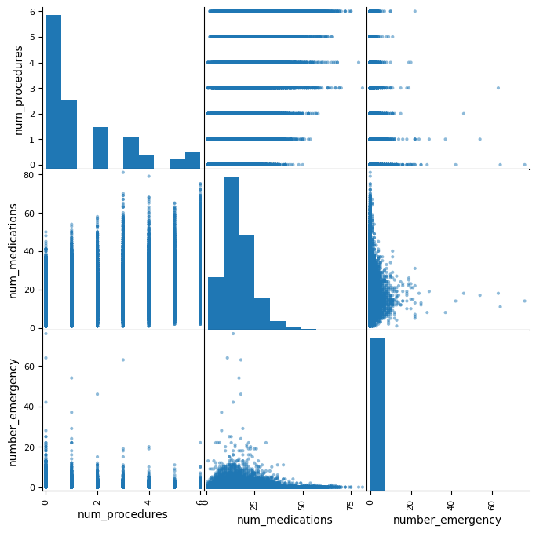
Data Understanding
Performing Exploratory data analysis to get a basic sense about the data.
Since there are multiple variables,
trying to figure out the correlation
so that we can use less variables.

Slide 11
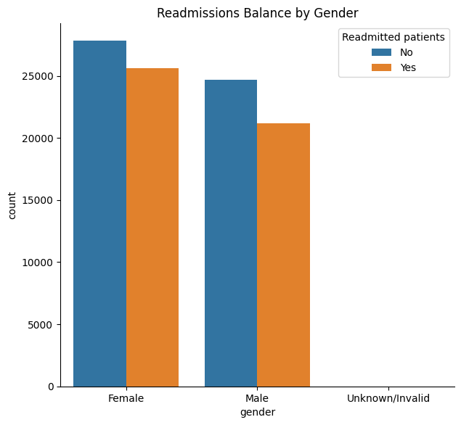
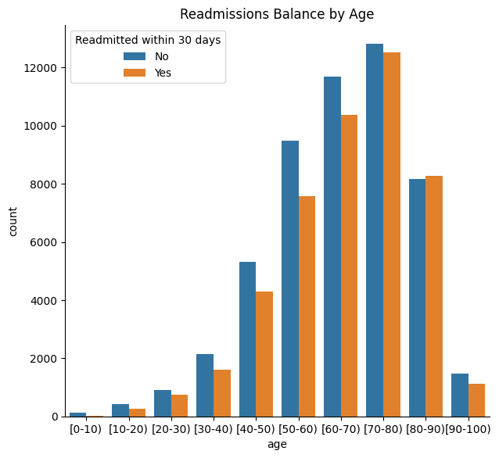
Data Understanding
Figuring out the effect of different variables on readmission,

Slide 12
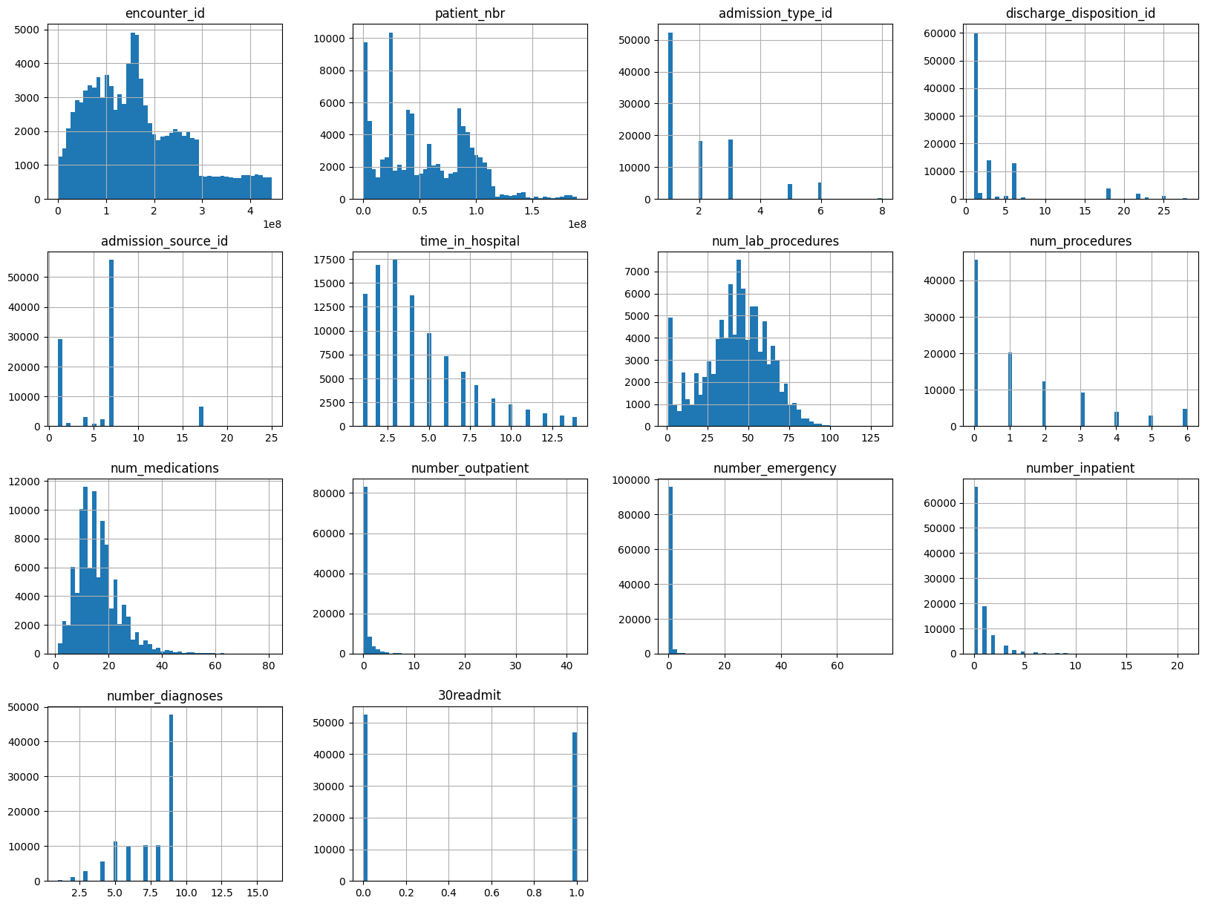
Data Understanding
Viewing the numerical and categorical variables in the dataset to understand the dataset better

Slide 13
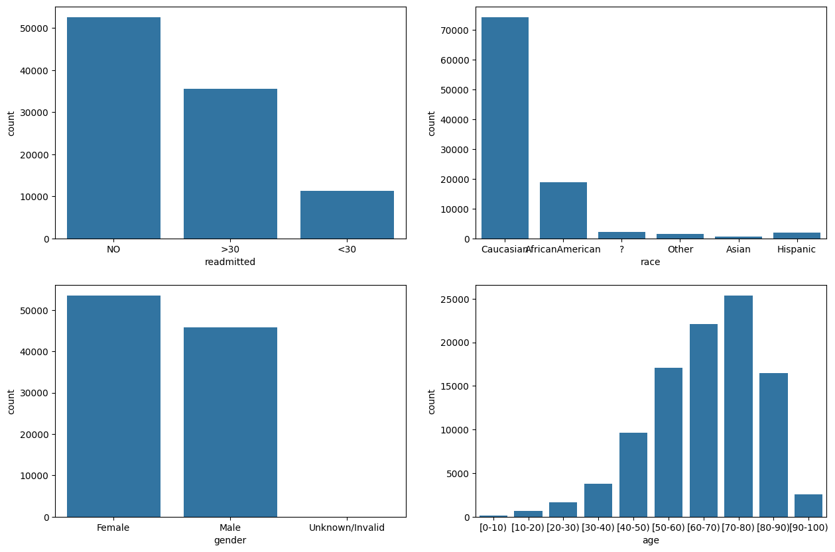
Data Understanding
Viewing the numerical and categorical variables in the dataset to understand the dataset better,

Slide 14
Data Preparation
We had different types of data: numerical, object type and categorical. To apply any model, preprocessing of data is essential.
Dealing with the missing values by dropping the columns which had too many missing values.
Modifying the data like standardization, log transform.
Dealing with the categorical variable like Readmitted to make it dummy variable suitable for applying ML techniques.
The challenge was that there were too many variables so cleaning and making sense of the data was a challenge but step by step approach helps!

Slide 15
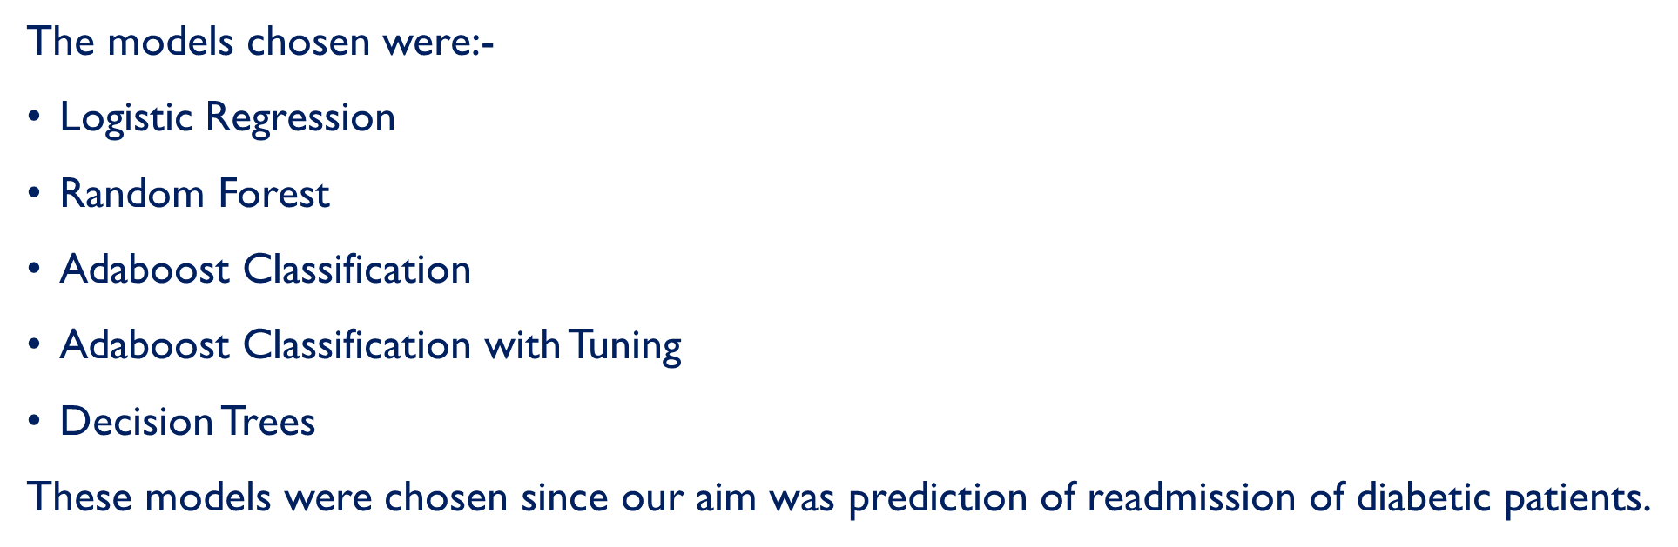
Modeling, Evaluation and Feedback

Slide 16
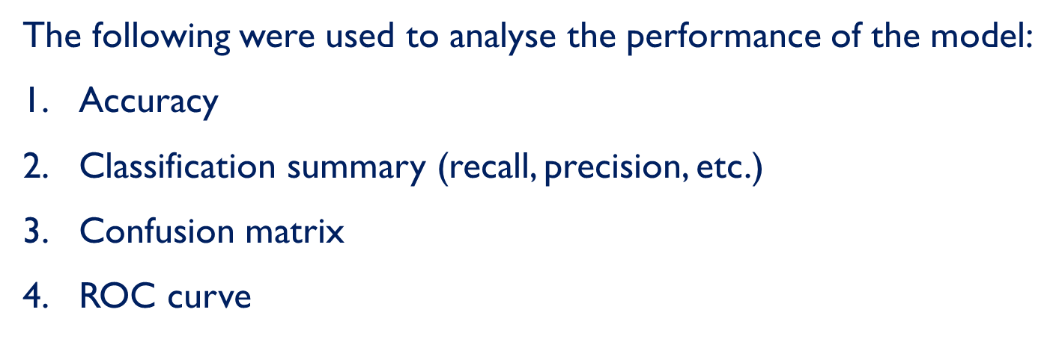
Modeling, Evaluation and Feedback

Slide 17
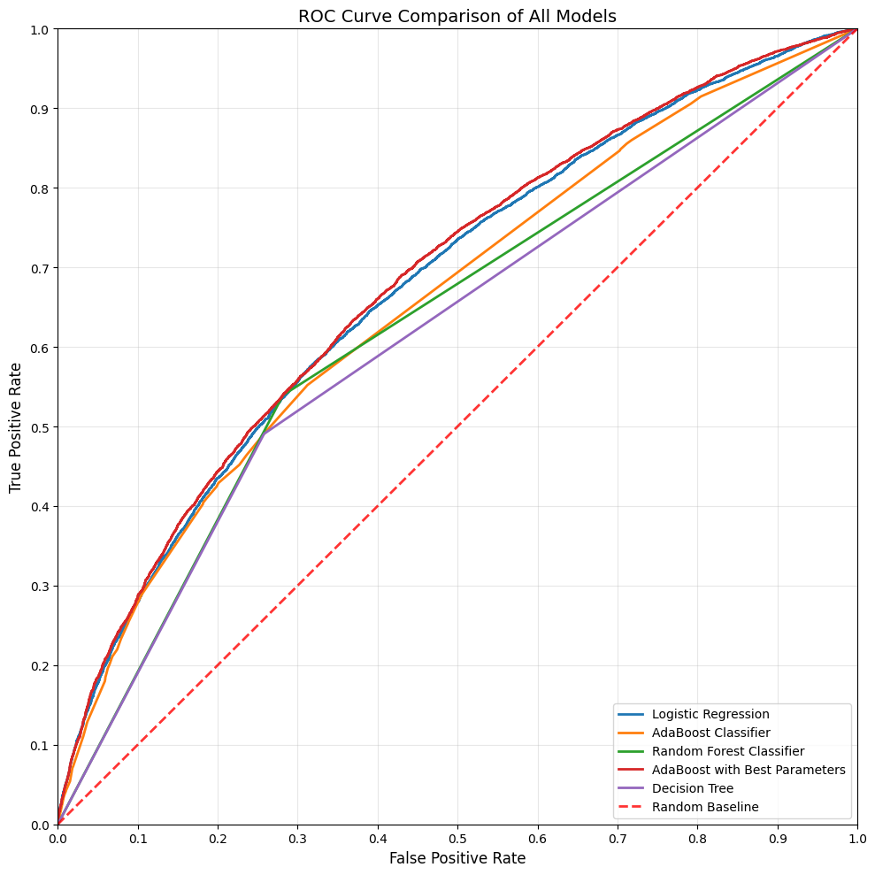
Modeling, Evaluation and Feedback
ROC curve:

Slide 18
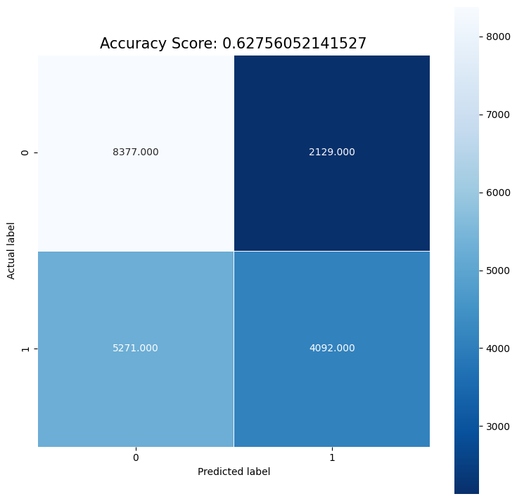
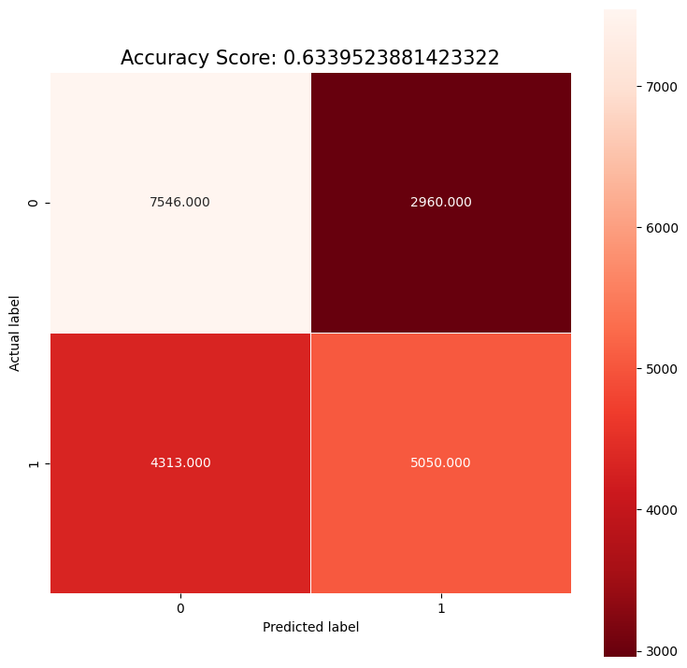
Modeling, Evaluation and Feedback
Logistic regression
Random Forest Classification

Slide 19
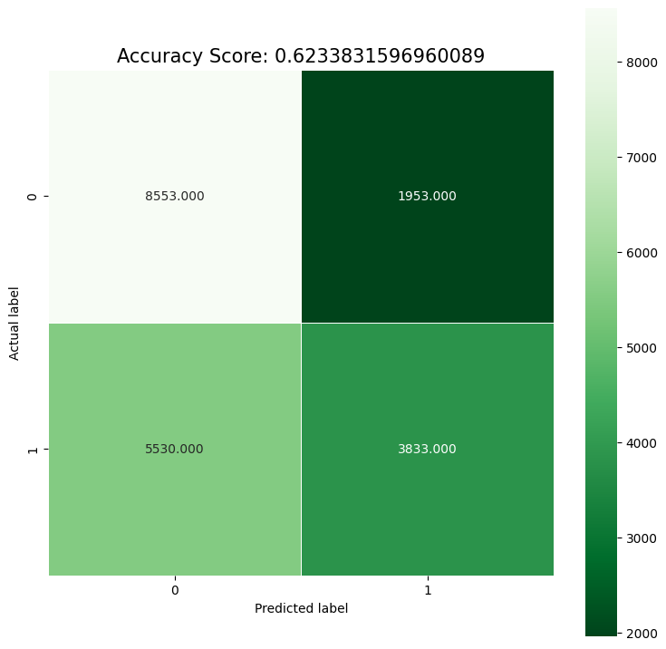
Modeling, Evaluation and Feedback
Adaboost Classification

Slide 20
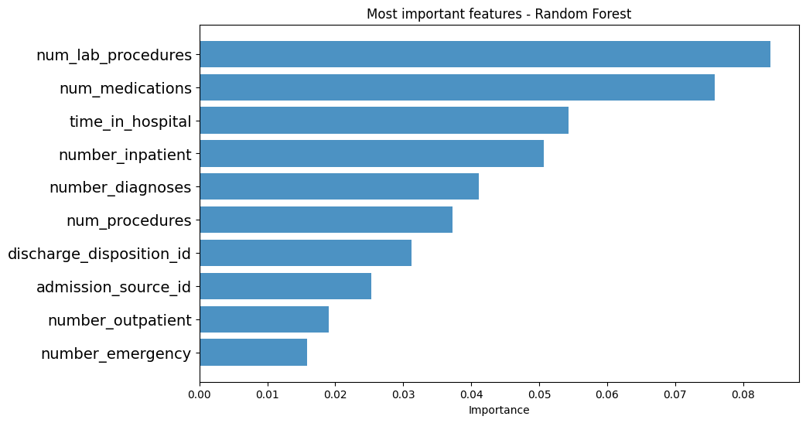
“feature importance” visualization
From deploying multiple models, we came up with Random forest.
Now we can suggest to the hospital authorities the variables which have the most effect on the readmission rate.
The diagram below explains it all:-

Slide 21
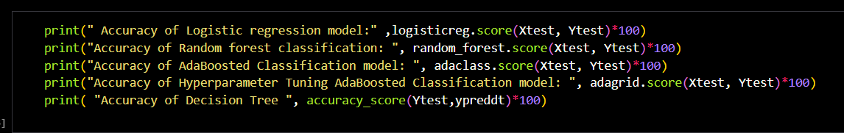
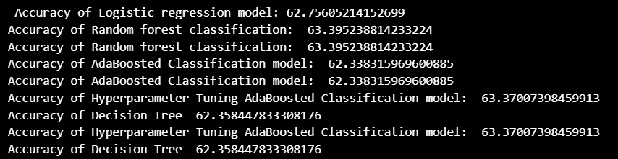
Results
Accuracy of the models:

Slide 22
Assumptions, Limitations & Further Works
The dataset includes some useful information but still lack certain aspects like access to care etc. which might impact the readmission to a huge extent.
More data preprocessing could have been performed to improve the model accuracy further. So, in future this is one area which can be explored.
Variations of different machine learning techniques can be used.

Slide 23
Conclusion
This project explored supervised learning to predict diabetes-related outcomes using the dataset in `diabetic_data.csv` (with supporting mappings from `IDS_mapping.csv`). We performed exploratory analysis and trained multiple baseline and tree-based models, then evaluated them on a held-out set
Preprocessed the data (encoding and feature preparation as shown above) and trained several classifiers.
Benchmarked models including Logistic Regression, Decision Tree, Random Forest, and AdaBoost (with and without tuning).
Compared performance on a consistent evaluation split.
Best accuracy: 63.40% from Random Forest.
Close contenders: AdaBoost (tuned) at 63.37%, Logistic Regression at 62.76%, Decision Tree at 62.36%, and AdaBoost at 62.34%.
The prediction array length indicates we evaluated on ~19.9k samples, ensuring results reflect generalization on a sizable test set.

Slide 24
References
Strack et al., Impact of HbA1c measurement on hospital readmission rates — BioMed Research International (2014). PMC
Cui et al., An improved support vector machine-based diabetic readmission prediction — Computer Methods and Programs in Biomedicine (2018). ScienceDirect
Zhao & Yoo, A self-adaptive 30-day diabetic readmission prediction model based on incremental learning — IEEE BIBM (2017). ResearchGate
Sarthak et al., EmbPred30 — arXiv preprint (2020). arXiv
Zheng et al., Predictive modeling of hospital readmissions using metaheuristics and data mining — Expert Systems with Applications (2015). ScienceDirect
Shang et al., The 30-days hospital readmission risk in diabetic patients — BMC Medical Informatics and Decision Making (2021). BioMed Central
Liu et al., Comparison of machine learning models for predicting 30-day readmission in patients with diabetes — JMAI (2024) (benchmark/review). J Med Artif Intell

